Slide 1
Project Title:
DECENTRALIZED SAN USING THRESHOLD CRYPTOGRAPHY
M.S. Ramaiah Institute of Technology
(Autonomous Institute, Affiliated to VTU)
Department of Computer Science and Engineering
Course Name: Storage Area Networks
Course Code:CSE734
Under the guidance of
Assistant Prof. Brunda G
By:
Name USN
B Karthik 1MS22CS038
Aditya U Yashwant 1MS22CS017

Slide 2
Problem Statement
Traditional Storage Area Networks (SANs) are centralized, making them:
  Single points of failure
  Vulnerable to insider threats (admins, cloud providers)
  Targets for ransomware and data breaches
Users must fully trust the storage provider with raw data and encryption keys
Existing cloud SANs cannot guarantee zero-knowledge storage
Why It Is Important
Rising data breaches and compliance requirements (GDPR, HIPAA)
Need for confidential, tamper-proof, owner-controlled storage
Critical for enterprise, healthcare, finance, and research data

Slide 3
Objectives
Design a trustless decentralized SAN
Ensure no single entity can access plaintext data
Implement client-side encryption
Split encryption keys using Shamir’s Secret Sharing
Store encrypted data in IPFS
Use blockchain for immutable metadata and ownership verification
Demonstrate secure upload and retrieval workflows

Slide 4
Related Work / Background
Existing SAN & Storage Solutions
Traditional SANs (Fibre Channel, iSCSI)
Cloud Storage (AWS S3, Azure Blob)
Distributed Storage (Ceph, HDFS)
Decentralized Storage (IPFS, Storj, Filecoin)
Identified Gap
Most solutions:
  Either decentralize storage only
  Or still rely on centralized key management
Gap: Lack of a fully trustless SAN combining:
  Client-side encryption
  Distributed key ownership
  Blockchain-based verification

Slide 5
Literature Review
Sl. No. | Author & Year | Title of the Paper | Key Focus / Method Used | Findings / Contribution | Limitations / Research Gap Identified
1 | D. Yang , 2024 | An Optimized Encryption Storage Scheme for Blockchain Data Using Threshold Secret Sharing | Threshold secret sharing with blockchain | Improved data confidentiality and fault tolerance | Storage overhead and limited SAN integration
2 | M. R. Haque , 2025 | Integrated Blockchain and IPFS-Based Solution for Secure Version Control | Blockchain + IPFS integration | Secure, immutable version control | Focuses on versioning, not key decentralization

Slide 6
Literature Review
Sl. No. | Author & Year | Title of the Paper | Key Focus / Method Used | Findings / Contribution | Limitations / Research Gap Identified
3 | P. Sharma , 2021 | Blockchain-Based Decentralized Architecture for Cloud Storage | Decentralized cloud storage design | Improved trust and availability | Centralized key handling remains
4 | T. V. Doan , 2022 | Toward Decentralized Cloud Storage With IPFS | IPFS-based decentralized storage | Identifies scalability and performance issues | Lacks encryption & access control
5 | J. Benet, 2014 | IPFS—Content Addressed, Versioned, P2P File System | Content-addressed P2P storage | Foundation of decentralized storage | No built-in security or key management

Slide 7
Literature Review
Sl. No. | Author & Year | Title of the Paper | Key Focus / Method Used | Findings / Contribution | Limitations / Research Gap Identified
6 | M. Steichen , 2018 | Blockchain-Based Decentralized Access Control for IPFS | Blockchain access control | Secure authorization over IPFS | Does not address key confidentiality
7 | J. Sun , 2020 | Blockchain-Based Secure Storage for Medical Records in IPFS | Secure healthcare data storage | Combines IPFS & blockchain securely | Centralized encryption key storage
8 | Q. Zheng , 2018 | IPFS-Based Storage Model for Blockchain | Reducing blockchain storage cost | Efficient off-chain data storage | Security mechanisms not explored
9 | E. Daniel & F. Tschorsch, 2022 | IPFS and Friends: A Qualitative Comparison | Comparison of P2P storage systems | Evaluates IPFS strengths and weaknesses | No trustless security model proposed

Slide 8
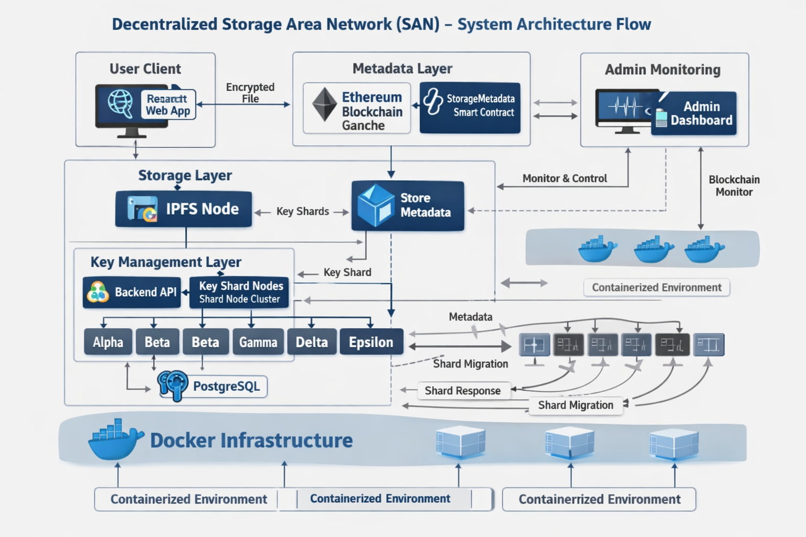
Proposed System / Design

Slide 9
Proposed System / Design
Proposed Decentralised SAN Architecture
Client-Side Encryption using AES-256-GCM
Key Splitting using Shamir’s Secret Sharing (k=3, n=5)
Encrypted Data Storage on IPFS
Distributed Key Nodes (Alpha–Epsilon)
Blockchain Smart Contract for metadata & ownership
Tools & Technologies
Frontend: React, Vite
Backend: Node.js, Express
Storage: IPFS
Database: PostgreSQL
Blockchain: Ethereum (Ganache)

Slide 10
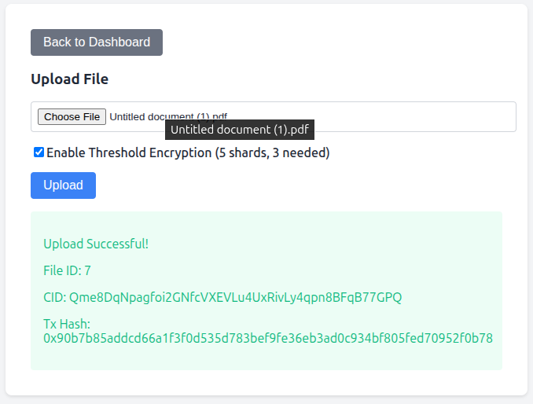
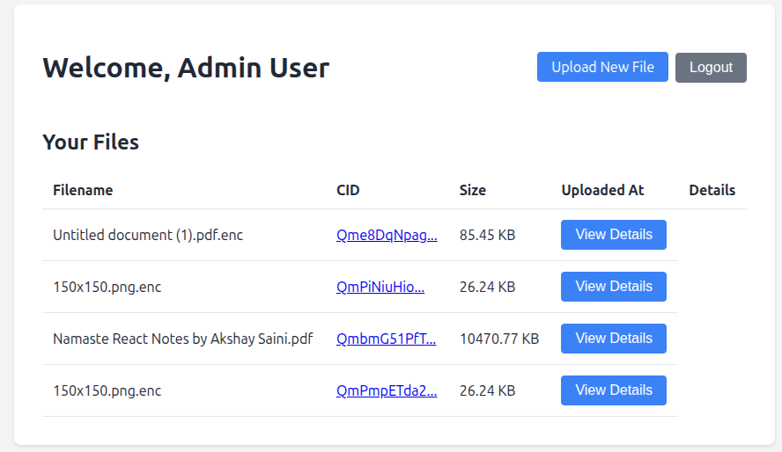
Implementation
Implementation Details
Client Side
  File encryption in browser
  Key splitting before upload
Backend
  Node.js cluster managing shard distribution
  Independent PostgreSQL databases
Blockchain
  Smart contract storing:
    File hash (CID)
    Owner address
Environment
  OS: Linux
  Tools: MetaMask, Ganache, IPFS daemon

Slide 11
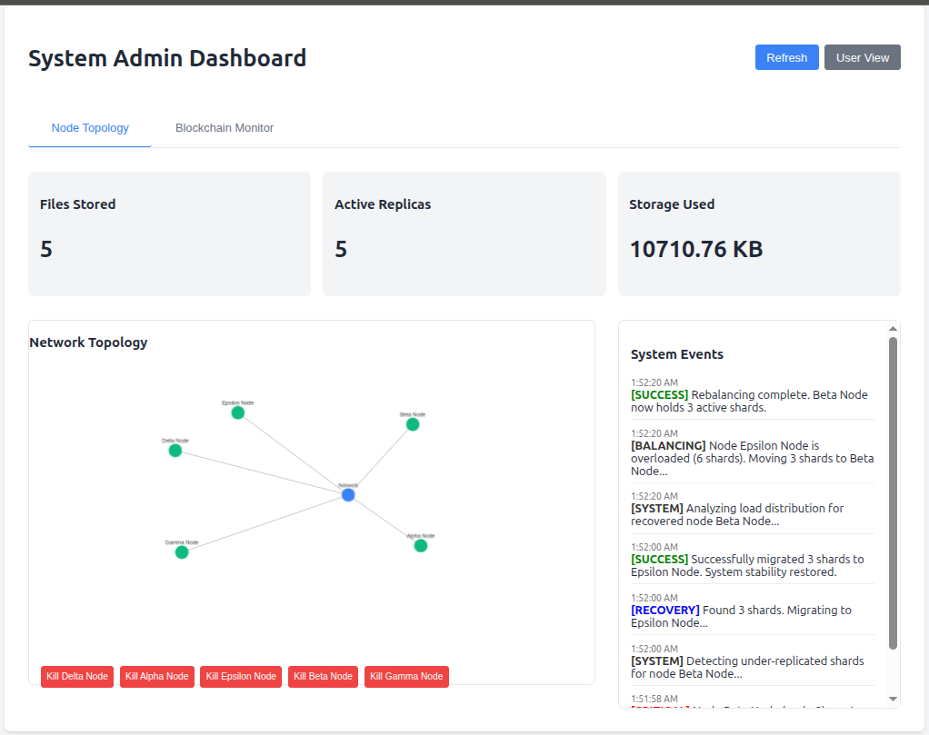
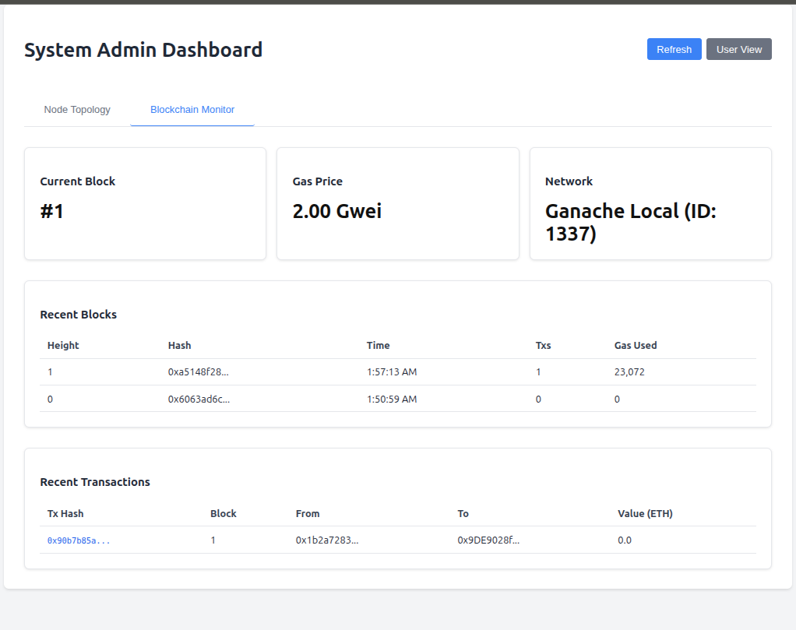
Implementation

Slide 12
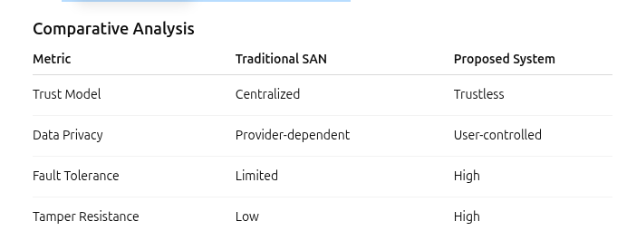
Results & Analysis
Performance Observations
Encryption overhead is minimal (client-side)
IPFS upload scales efficiently
Key reconstruction successful with ≥3 shards

Slide 13
Security Measures (if applicable)
Security Mechanisms Used
Encryption: AES-256-GCM
Key Protection: Shamir’s Secret Sharing
Access Control: Blockchain-based ownership verification
Isolation: Independent key nodes
Zero-Knowledge Storage: No plaintext exposure
SAN Concepts Applied
Logical zoning of key nodes
Key masking through secret sharing
Secure API access control

Slide 14
Conclusion & Future Scope
Conclusion
Successfully designed and implemented a Trustless Decentralized SAN
Eliminated single points of trust
Ensured confidentiality, integrity, and availability
Demonstrated secure file upload and retrieval
System is academically valid and practically scalable
Future Enhancements
Smart-contract based access delegation
Integration with Filecoin incentives
Threshold signatures instead of key reconstruction
Large-scale node federation
Performance benchmarking on public Ethereum

Slide 15
References
[1] D. Yang, X. Liu, Y. Zhang, and H. Wang, “An optimized encryption storage scheme for blockchain data using threshold secret sharing,” IEEE Access, vol. 12, pp. 107956–107975, 2024.
[2] M. R. Haque, N. Abdullah, A. Manzoor, and A. Alhajj, “An integrated blockchain and IPFS-based solution for secure and efficient version control,” PLoS ONE, vol. 20, no. 9, p. e0331131, 2025.
[3] P. Sharma, V. Garg, M. A. Kaafar, and J. P. Shim, “Blockchain-based decentralized architecture for cloud storage,” Journal of Cloud Computing, vol. 10, no. 1, p. 9, 2021.
[4] T. V. Doan, V. Bajpai, Y. Psaras, and J. Ott, “Toward decentralized cloud storage with IPFS: Opportunities, challenges, and future considerations,” IEEE Internet Computing, vol. 26, no. 6, pp. 7–15, Nov./Dec. 2022.
[5] J. Benet, “IPFS—Content addressed, versioned, P2P file system,” arXiv preprint arXiv:1407.3561, 2014.
[6] M. Steichen, B. Fiz, R. Norvill, W. M. Shbair, and R. State, “Blockchain-based, decentralized access control for IPFS,” in Proc. IEEE Int. Conf. Internet of Things (iThings), 2018, pp. 1499–1506.
[7] J. Sun, X. Yao, S. Wang, and Y. Wu, “Blockchain-based secure storage and access scheme for electronic medical records in IPFS,” IEEE Access, vol. 8, pp. 59389–59401, 2020.
[8] Q. Zheng, Y. Li, P. Chen, and X. Dong, “An innovative IPFS-based storage model for blockchain,” in Proc. IEEE/WIC/ACM Int. Conf. Web Intelligence, 2018, pp. 704–708.
[9] E. Daniel and F. Tschorsch, “IPFS and friends: A qualitative comparison of next generation peer-to-peer data networks,” IEEE Communications Surveys & Tutorials, vol. 24, no. 1, pp. 31–52, 2022.
[10] D. Trautwein et al., “Design and evaluation of IPFS: A storage layer for the decentralized web,” in Proc. ACM SIGCOMM, 2022, pp. 739–752.

